Slide 1
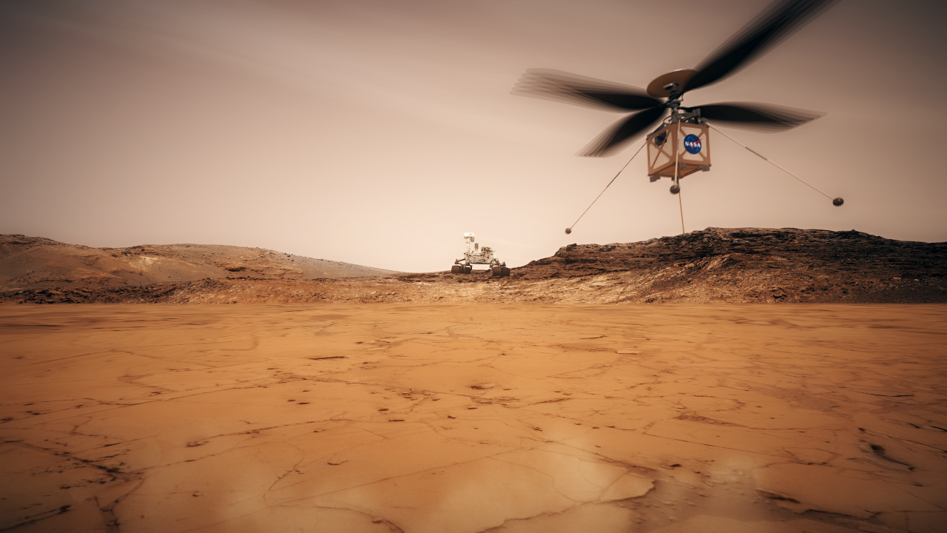
Mars Helicopter
Technology Demonstration on Mars 2020
FISO Telecon 03-20-2019
Joint effort of Jet Propulsion Laboratory, NASA Ames Research Center, NASA Langley Research Center, and AeroVironment
Håvard Fjær Grip – Mars Helicopter Flight Control & Aerodynamics Lead
Jet Propulsion Laboratory, California Institute of Technology
Copyright 2019 California Institute of Technology. Government sponsorship acknowledged.

Slide 2
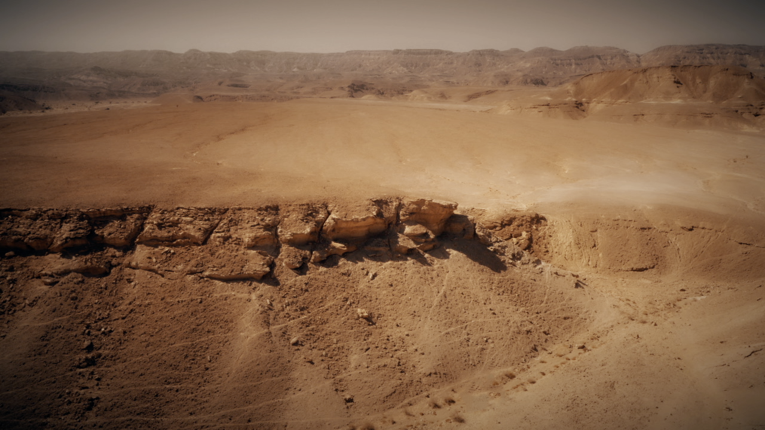
(Illustration)
Aerial Dimension:
Bridges gap between orbital and ground-level imagery

Slide 3
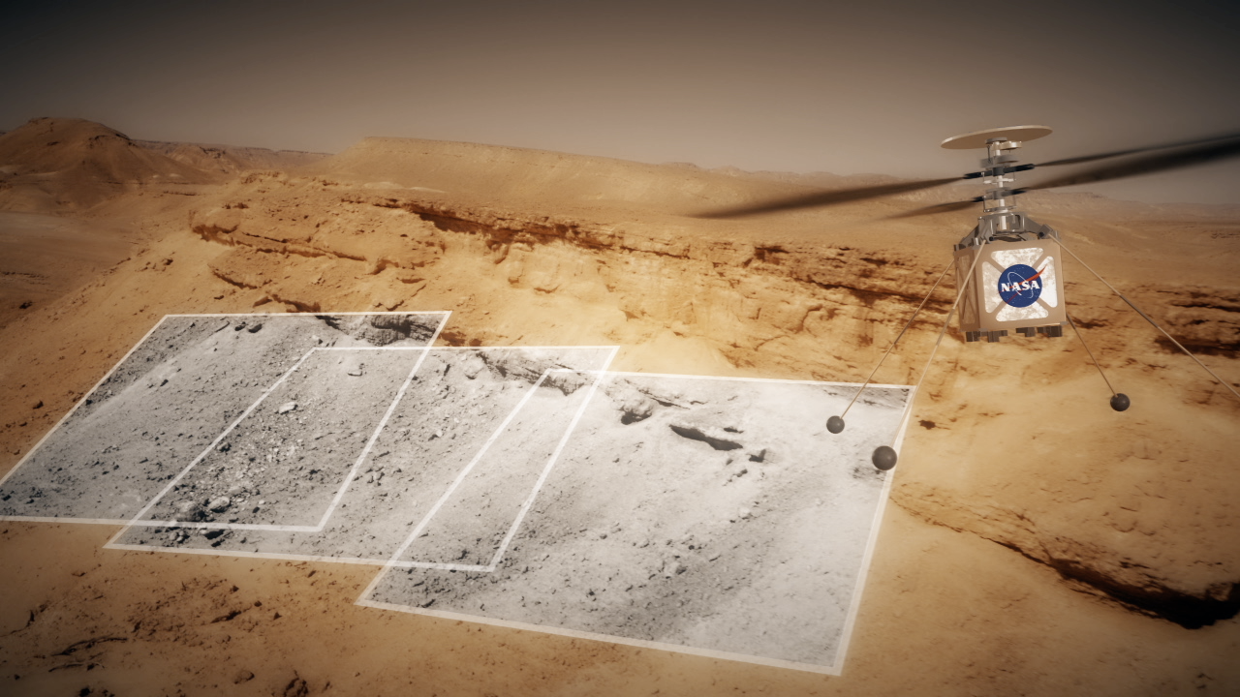
(Illustration)
Aerial Dimension:
Scouts terrain far ahead of rovers, and possibly someday, humans

Slide 4
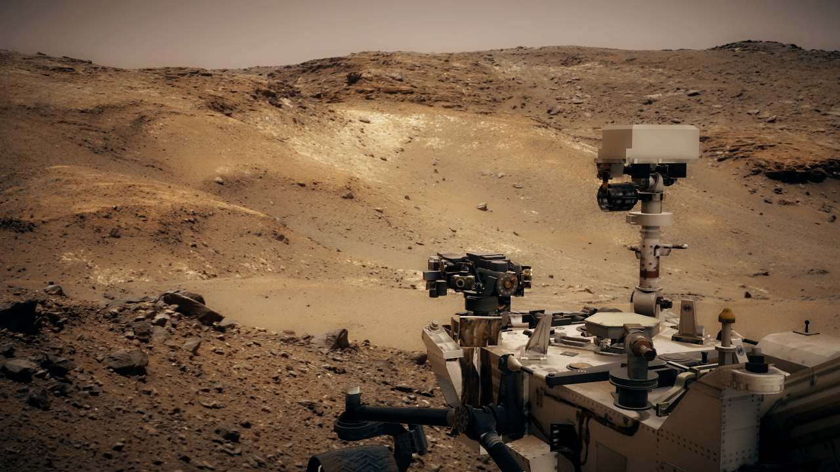
(Illustration)
Aerial Dimension:
Goes where it is inaccessible for rovers or humans

Slide 5
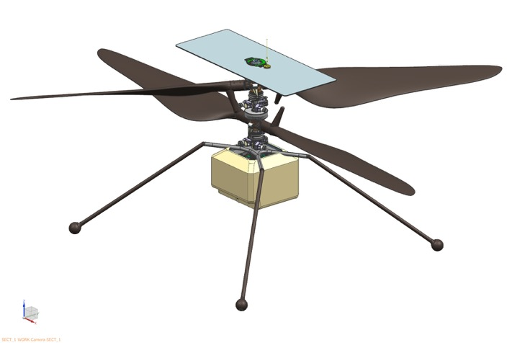
Mars Helicopter Technology Demonstrator
Co-axial rotor configuration
Blades 1.2-meter tip-to-tip
Mass ~1.8 kg
Battery powered
Recharges using solar panel

Slide 6
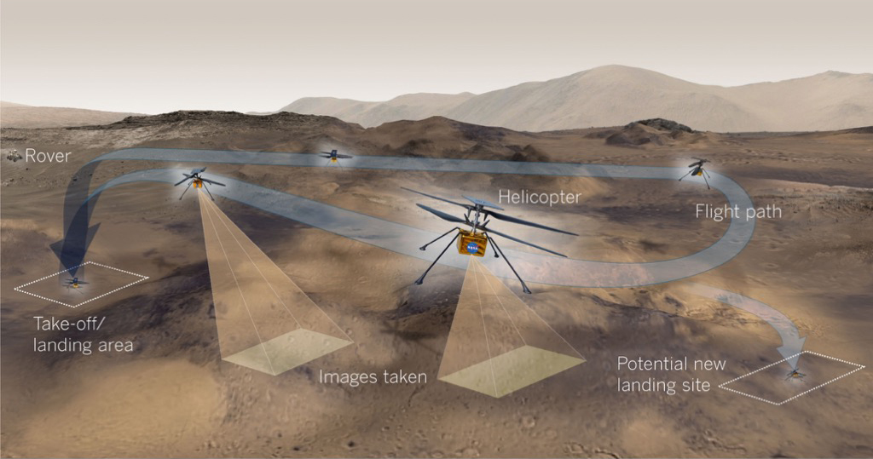
Demonstration Flights at Mars

Slide 7
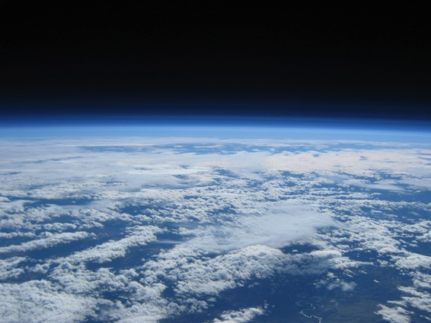
Challenges
Launch loads
Vacuum compatibility
Temperature extremes
Planetary protection
Radiation
No global navigation aids
Large communication lag with Earth
Extremely thin atmosphere
Only 1-2% of Earth density
Partially “offset” by lower gravity (38% of Earth)
Density equivalent to ~100,000 feet above sea level

Slide 8
Basic Scaling
Rotor size R limited by accommodation constraints (R = 0.605 m)
Density ρ is ~1% of Earth (ρ_{Mars} = 0.01 ρ_{Earth})
Speed of sound c is approximately 76% of Earth (c_{Mars} = 0.76 c_{Earth})
Gravity g is 38% of Earth (g_{Mars} = 0.38 g_{Earth})
Max rotor speed Ω is limited by tip Mach number
Max speed for given rotor size: Ω_{Mars} = 0.76 Ω_{Earth}
Thrust scales T as Ω²ρ
Max thrust for given rotor size: T_{Mars} = 0.006 T_{Earth}
Mass m scales as T/g
Max vehicle mass for rotor size: m_{Mars} = 0.015 m_{Earth}
For given mass and rotor size, ideal hover power P scales as g^{3/2}/ρ^{1/2}
Ideal power for given mass/rotor size: P_{Mars} = 2.34 P_{Earth}

Slide 9
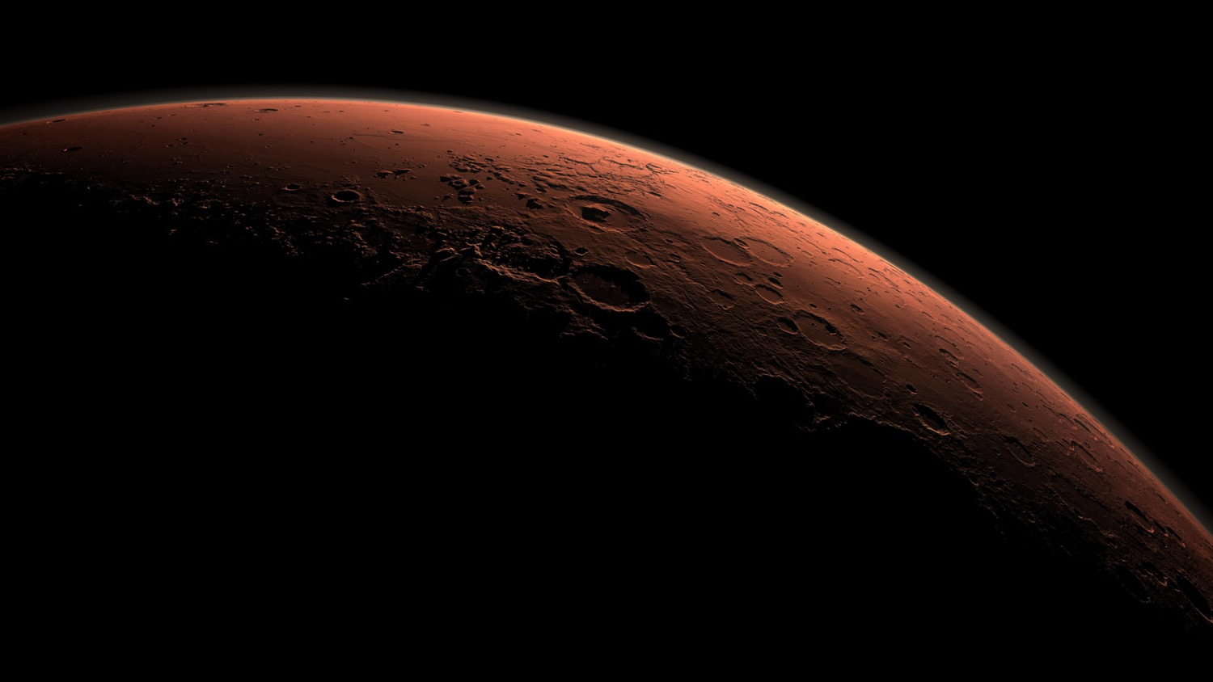
The Big Picture
Mass and power are primary design drivers
Big and fast rotor + small fuselage
Batteries will take up much of the available mass
Very little mass available for everything else

Slide 10
Question: Can helicopter flight be achieved on Mars?

Slide 11
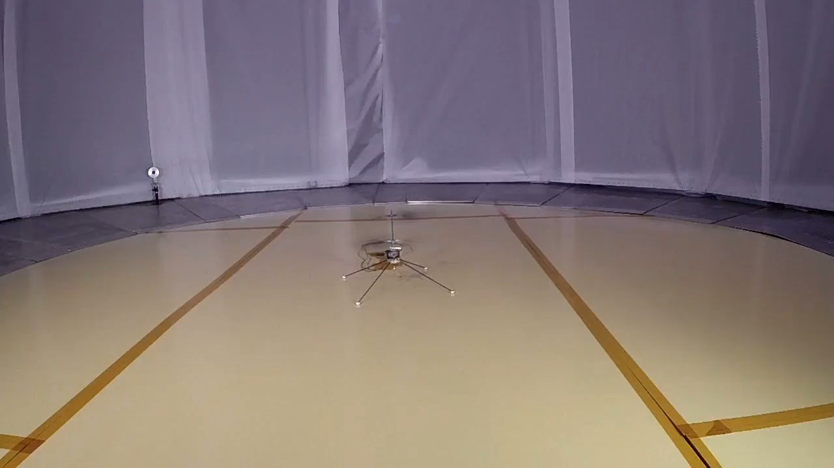
Early Test in Mars Atmosphere (2014)

Slide 12
Question: Can controlled helicopter flight be achieved on Mars?

Slide 13
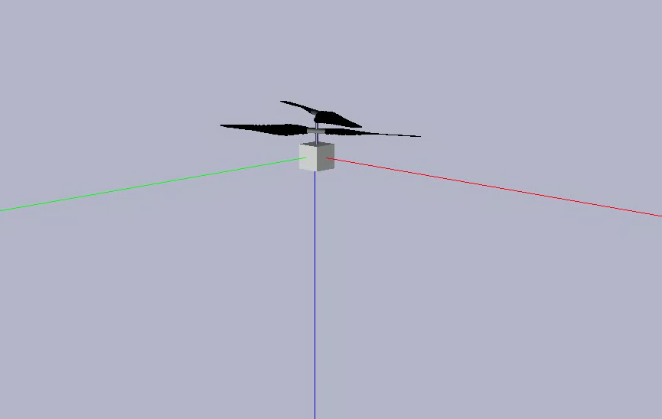
Controlled-Flight Demonstration Effort
Eight-month effort in 2015-2016 to demonstrate controlled flight in Mars atmosphere with full-size rotor
Driven heavily by flight dynamics modeling
Key insight: helicopter must be built for controllability
Early model of open-loop response

Slide 14
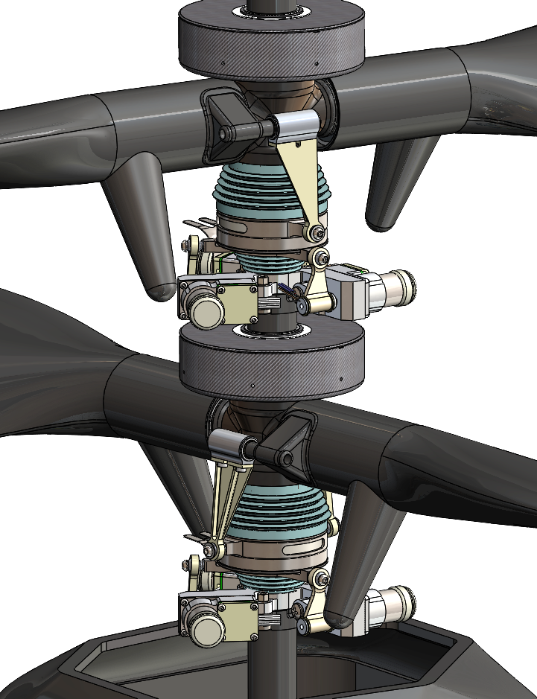
Helicopter is Controlled with Variable Pitch
Lift
Pitch controlled with servos
that move swashplates
Drag
Relative wind
Airfoil section
Increased pitch
Increased lift
Servo
Swashplate
Lift
Drag
Relative wind

Slide 15
Types of Pitch Variation
Collective control
Changes average blade pitch
Cyclic control
Changes blade pitch periodically
Increases lift on one side
Decreases lift on other side
Pitch up
Pitch up
Pitch down
Pitch up

Slide 16
Coax Control
Upper/lower collective input in same direction
Upper/lower collective input in opposite directions
Cyclic input
Tilted helicopter gains forward velocity

Slide 17
Flap Dynamics
Blade flapping similar to mass-spring-damper
Reduced damping on Mars changes response
In particular to periodic inputs – cyclic control and wind/gusts
Introduces highly oscillatory modes
Problematic for control
Mitigation: make rotor very stiff
80-90 Hz rotating flap frequency
Custom blade design using foam core with carbon fiber skin
Earth example
Mars

Slide 18
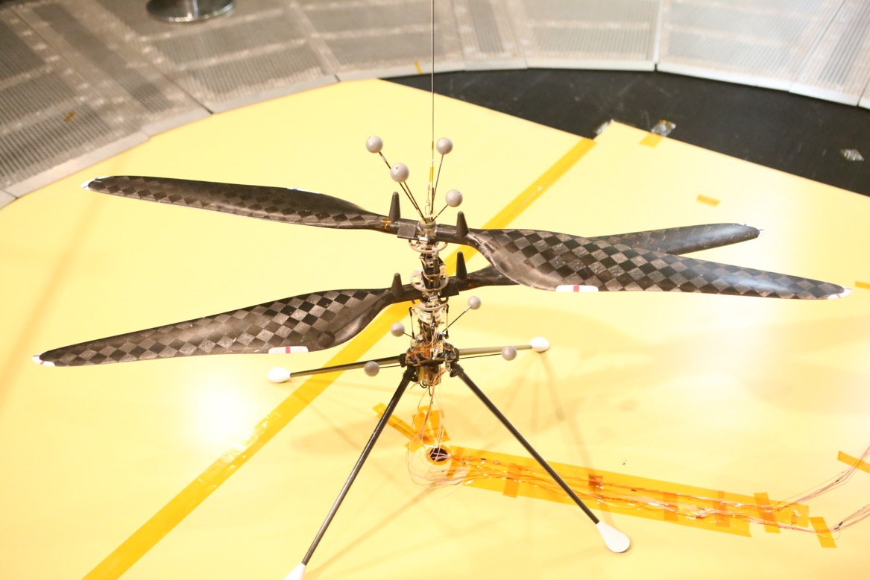
Full-Sized Rotor Mars Helicopter Prototype
Safety tether
(removed for free-flight)
Visual targets for Motion Tracking
Counter-rotating Rotors
Motor, gears &
pitch linkages Assembly
Electrical cables
Landing legs
1.2 meter Diameter Rotors

Slide 19
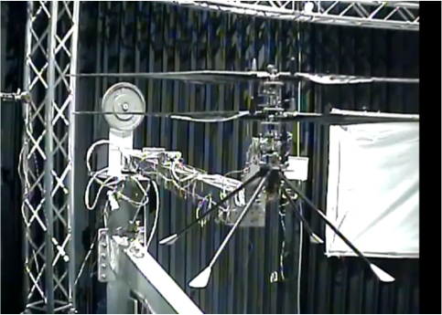
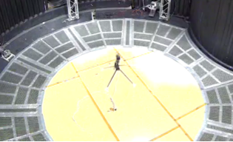
Path to Controlled Flight
Modeling and simulation
Vehicle Design
System identification
Attitude Control
Free flight

Slide 20
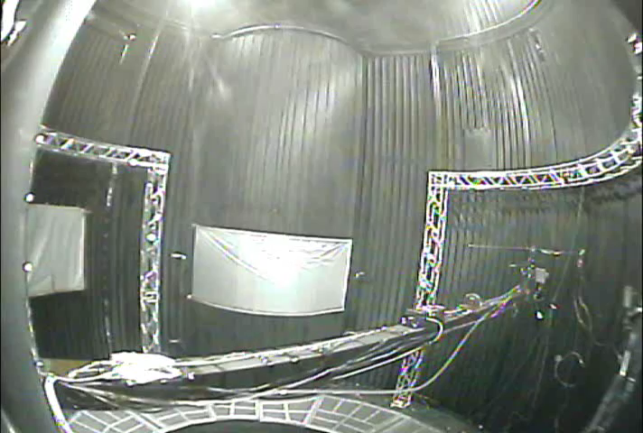
Swinging Arm Sys-ID

Slide 21

First Free Flight

Slide 22
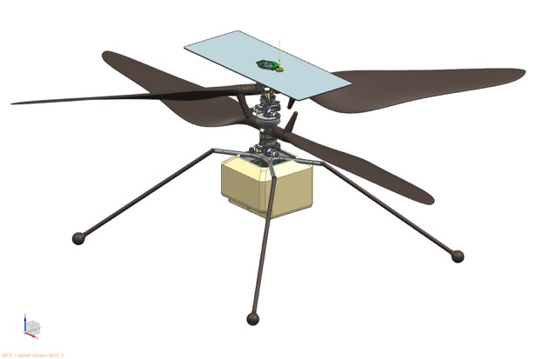
Flight Design
Main features of demo vehicle retained
Much heavier vehicle (1.8 kg)
Batteries, solar panel, avionics, sensors, etc.
Enabling factor: lightweight COTS technology
Batteries, avionics, sensors
Largely developed for cell phone and drone markets
Telecom
Rotor System
Solar Panel
Fuselage
Landing System
Battery
Avionics Processing
Sensors & Cameras

Slide 23
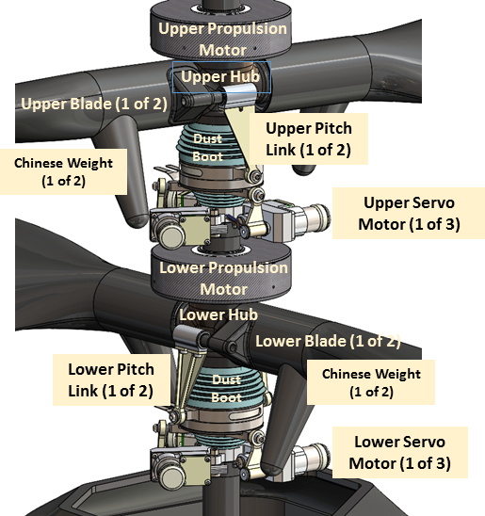
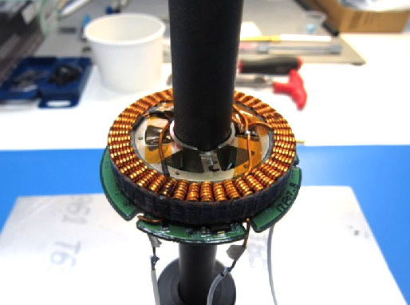
Rotor System
Identical upper and lower rotor
Collective -4.5˚ to 17.5˚
Cyclic -10˚ to +10˚
Carbon fiber composite
Maxon servo motors
Custom brushless drive motors with co-located drive electronics

Slide 24
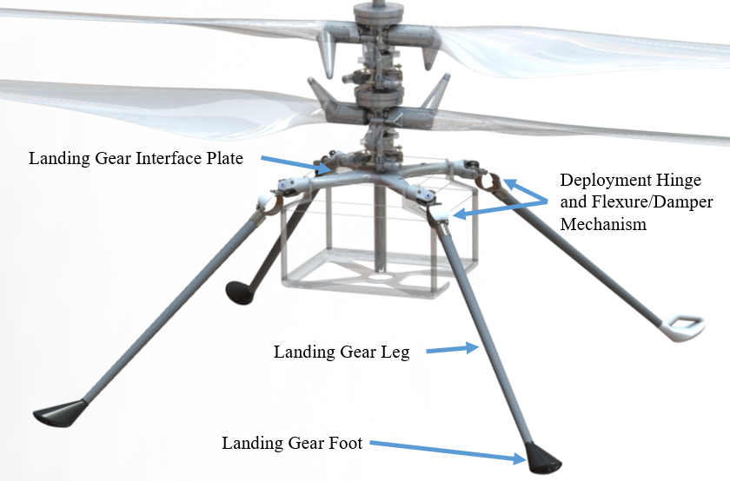
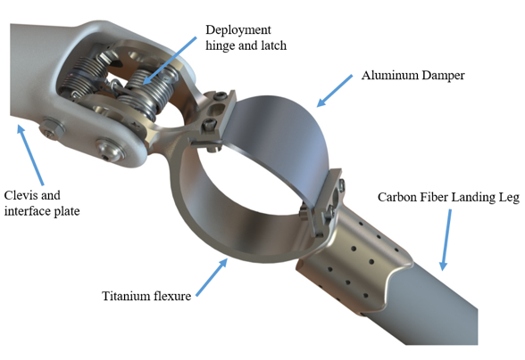
Landing Gear
Folded and deployed
Lightweight carbon fiber
Damping through deformable aluminum flexure
Ensures landing safety up to 2 m/s vertical contact velocity
Interface plate
Deployment hinge and flexure/damper mechanism
Leg
Foot
Deployment hinge and latch
Aluminum damper
Carbon fiber landing leg
Clevis and interface plate
Titanium flexure

Slide 25
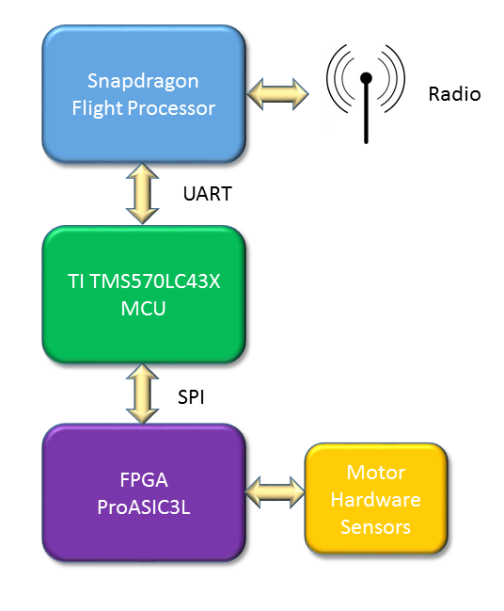
Avionics & Communications
COTS parts selected for thermal and radiation tolerance with additional custom mitigations as needed
Computing
Radiation tolerant FPGA
Redundant “hot swap” of flight controllers
High-Level navigation processor
Communications
Zig-Bee (802.15.4) protocol standard 900 MHz radio two node network

Slide 26
Power, Energy & Thermal
Solar Panel
Inverted Metamorphic Quadruple Junction (IMM4) solar cells
Tuned for Mars spectrum
Battery
Lithium ion
6 Sony VTC4 cells
510 W Peak Power
Thermal System
CO₂ gas-gap insulation
Survival heaters
High alpha fuselage coating
Low-conductivity composites
Optimized wire gages

Slide 27
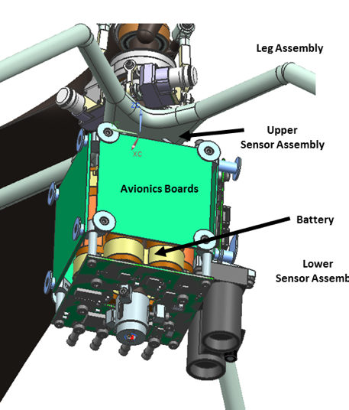
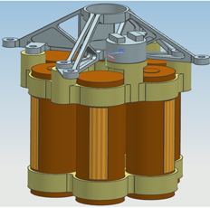
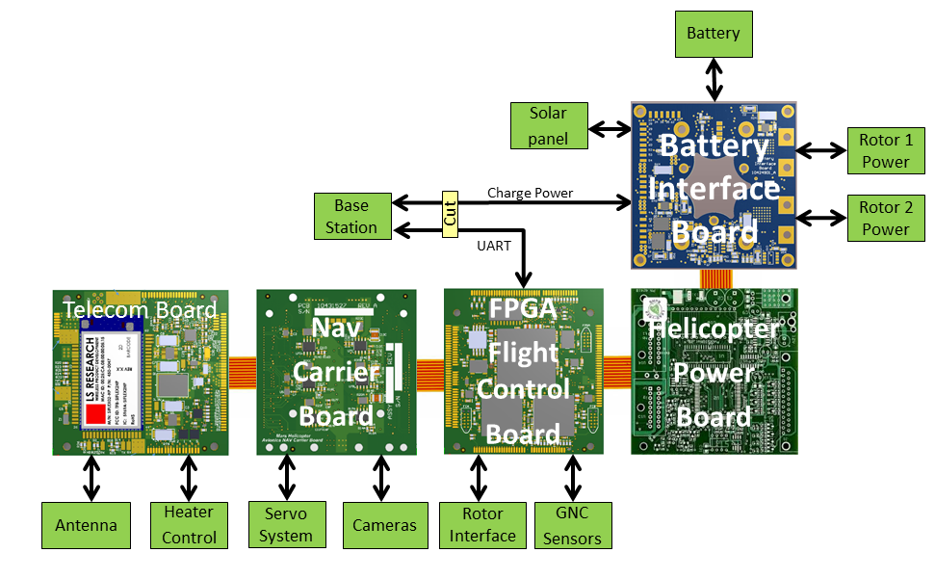
Electronics

Slide 28
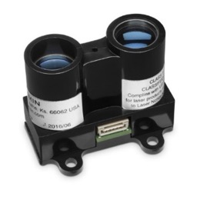
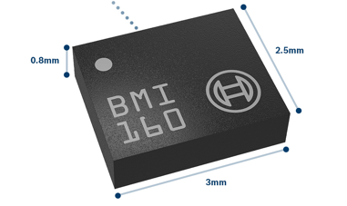
Sensors
IMU (Bosch Sensortec BMI-160)
Inclinometer (MEMS MuRata SCA100T-D02)
Altimeter (Garmin Lidar-Lite-V3)
Navigation (NAV) Camera (640 by 480 pixel Omnivision OV7251)
Return-to-Earth (RTE) Camera (4208 by 3120 pixel Sony IMX 214)
Garmin Lidar-Lite-V3
Altimeter
Bosch BMI-160 IMU

Slide 29
Guidance and Control
Classical nested control architecture: outer position loop around inner attitude loop
Guidance plans smooth trajectories between ground-provided waypoints
Takeoff strategy
“Jump” off ground with fixed thrust and limited control
Switch to full control after separating from ground
Landing strategy
Fly toward ground at constant speed
Switch off control when ground contact detected
As indicated by control residuals

Slide 30



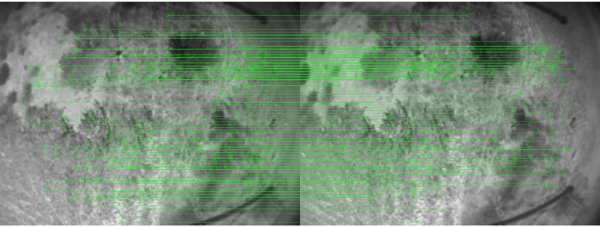
Navigation
Based on feature detection and tracking
FAST + KLT algorithms at 30-Hz frame rate
Features mapped onto ground plane
Assumed known
Mapped feature locations compared to predicted locations
Residuals used as filter innovations in Extended Kalman Filter

Slide 31
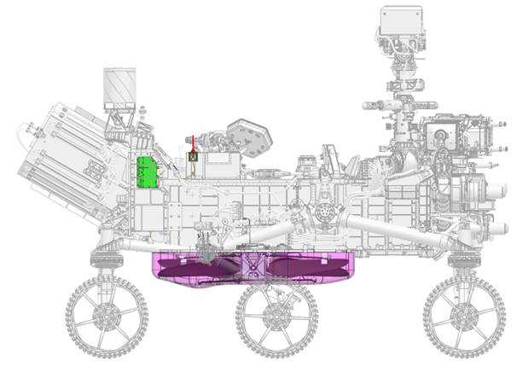
Rover Accommodation
Base Station Electronics
Base Station Antenna
Mars Helicopter (stowed)
Mars Helicopter Delivery System

Slide 32
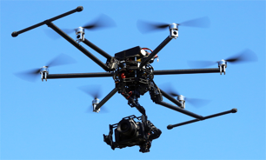
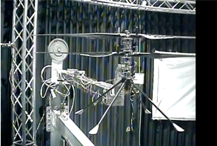
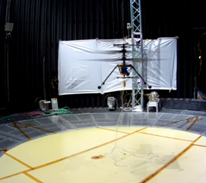
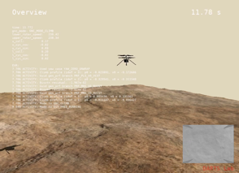
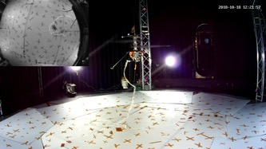
Flight Control Testing and V&V
Navigation testing
Control design &
robustness verification
Closed-loop testing
System identification
Integrated flight testing
Flight simulation

Slide 33
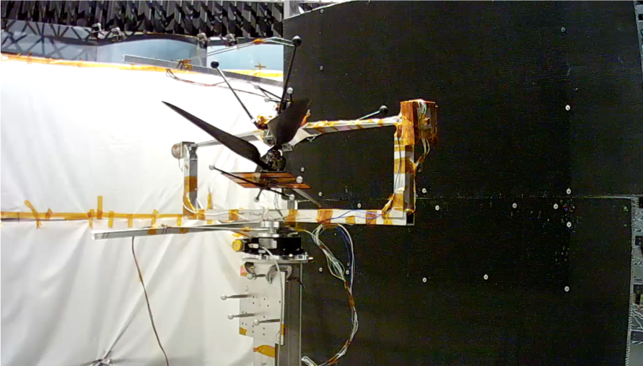
System Identification
Multiple configurations
Fixed on F/T sensor, swinging arm, gimbal
Forward flight testing using purpose-built wind wall
~900 CPU-type fans
Up to ~11 m/s

Slide 34
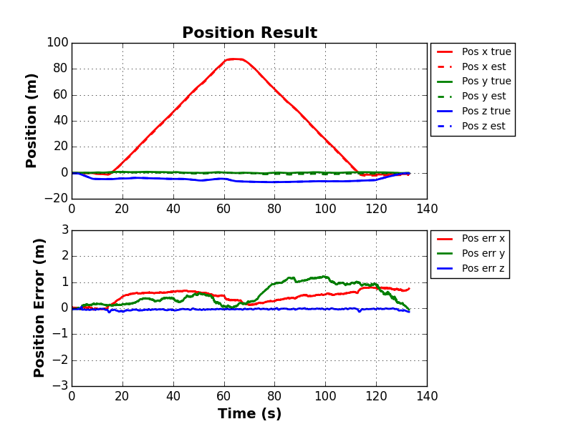
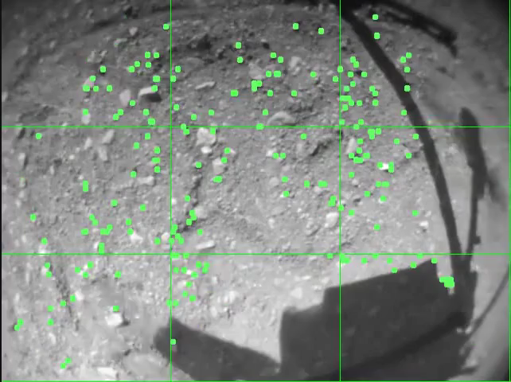
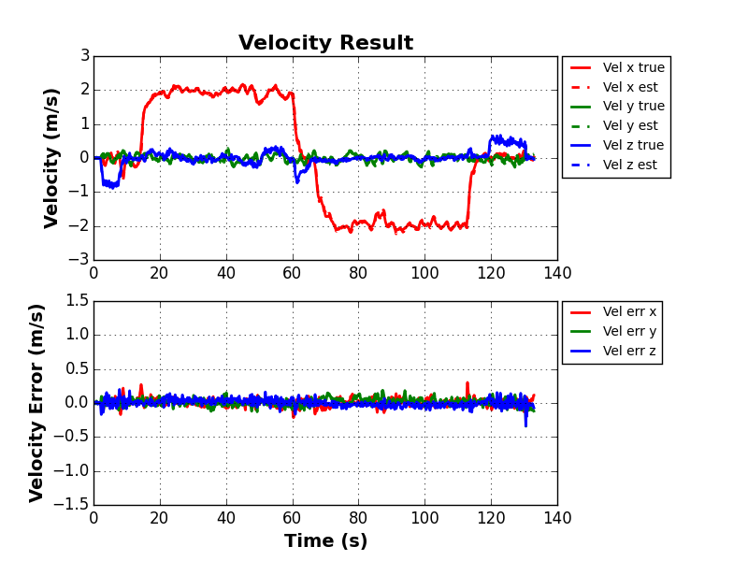
Navigation Testing
Outdoor testing with surrogate platform
Achieves sufficient photorealism
Space for large maneuvers
34

Slide 35
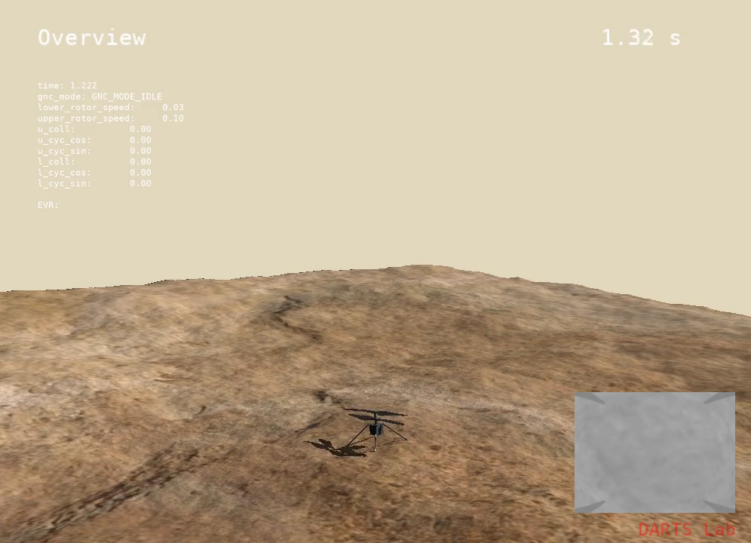
Flight Simulation
Simulations performed using HeliCAT
Flight software in the loop
Monte-Carlo variations

Slide 36
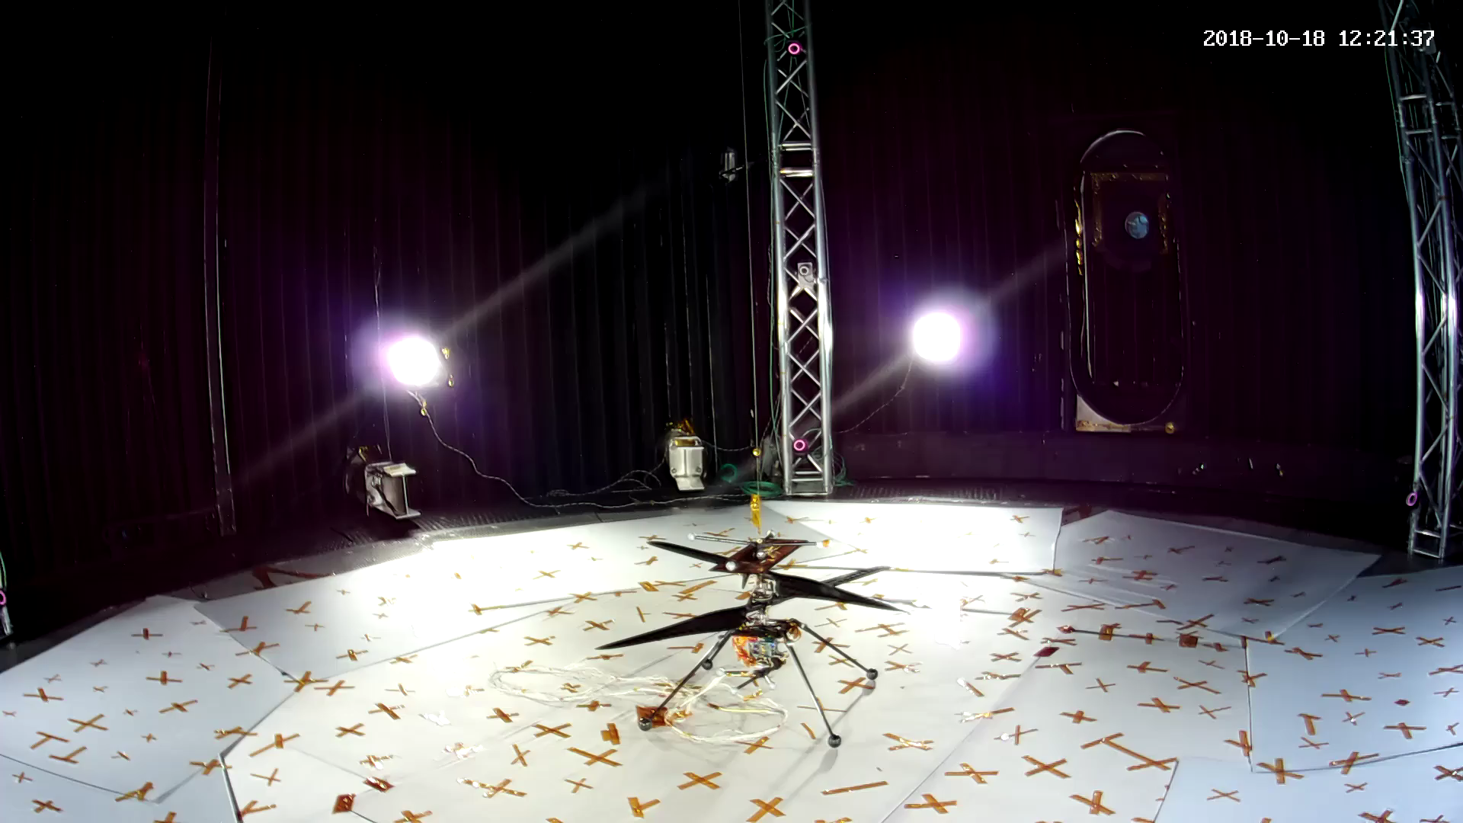
Flight With Onboard Navigation

Slide 37



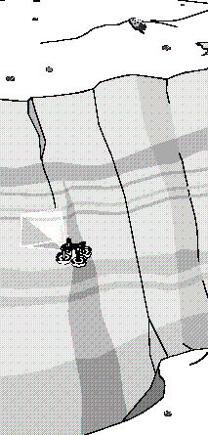

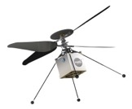
Opening Doors to New Classes of Exploration
ORBITERS
Wide-Area
Lower-Res Imaging
LANDERS
Single Location
No Mobility
Local High-Res Imaging
ROVERS
Limited Mobility
Local High-Res Imaging
ROVER PAIRED WITH SCOUT
Efficient Mobility
Wide-Area High-Res Imaging
INDEPENDENT
HELICOPTER SCOUT
Long-Range Mobility
Wide-Area High-Res Imaging
REGIONAL EXPLORATION USING MULTIPLE HELICOPTERS
BIOLOGICALLY SENSITIVE ZONE EXPLORATION
Pre-decisional information – for planning and discussion purposes only

